Slide 1
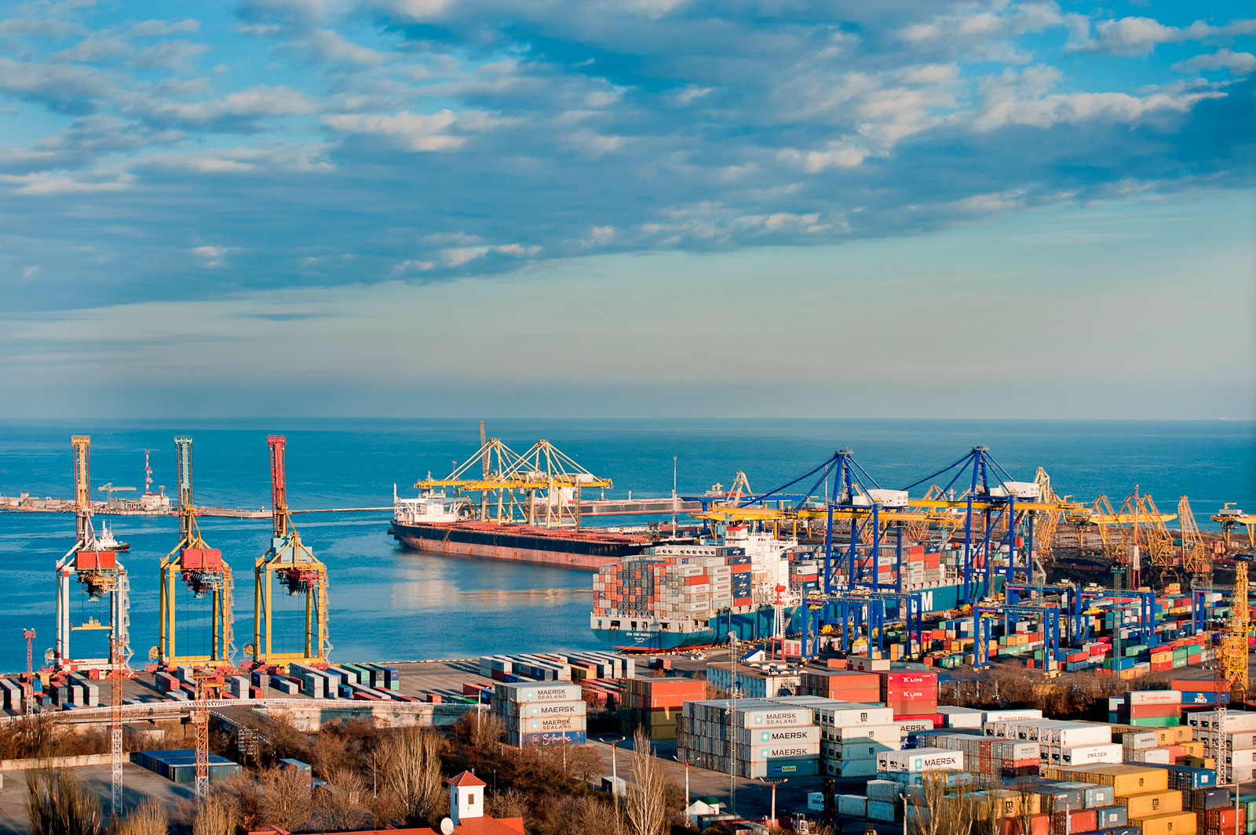

DIGITAL TWIN FOR ENERGY SYSTEM MANAGMENT
Prof. Sbarufatti Claudio Eng. Poloni Dario
A.Y. 2021-22
Group 02
NUCLEAR MARINE PROPULSION FLEET
Sophie Deanesi | 10607418
Davide Fracasso | 10567984
Zeno Mancassola | 10607116
Paolo Pontillo | 10565989
Davide Portello | 10624353

Slide 2
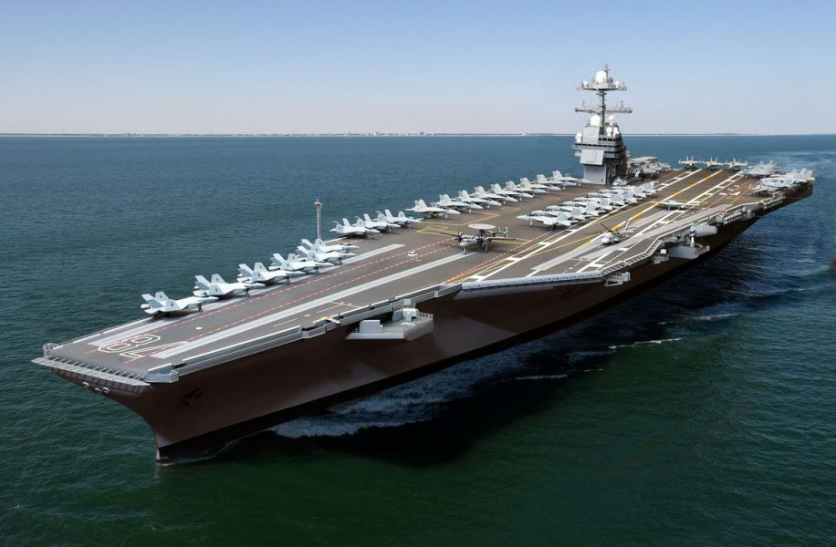
The problem
1
NUCLEAR MARINE PROPULSION FLEET
THE PROBLEM
POSSIBLE SHIP DAMAGES
MANAGEMENT
Degradation of admission valve of the turbine
Damage on bearing of the generator shaft
Crack propagation on the pressure vessel
Flow management
Maintenance operations
Personnel and material management
Cost analysis
Problem → Propulsion Model → Damages → Port model → Results

Slide 3
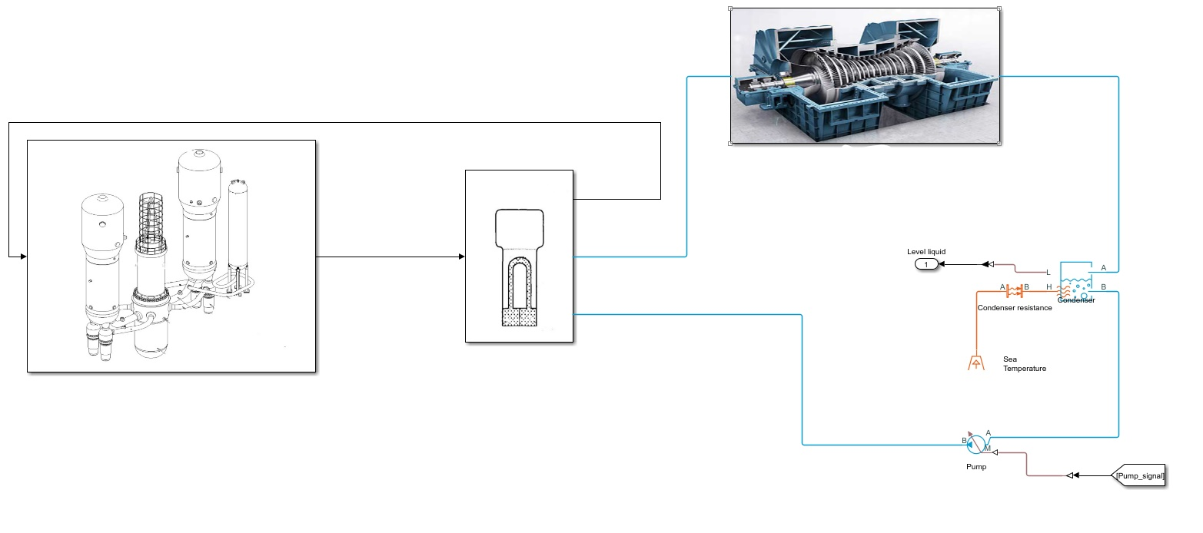
The Model
2
NAVAL PROPULSION REACTOR
~ 30 – 300 MWth
Fuel enrichment
TURBINE
CONDENSER
T_in
NUCLEAR REACTOR
U-TUBE STEAM GENERATOR
NUCLEAR REACTOR
AP600 PWR Westinghouse (1940 MWth)
T_in = 299.74 [°C]
PUMP
Problem → Propulsion Model → Damages → Port model → Results

Slide 4
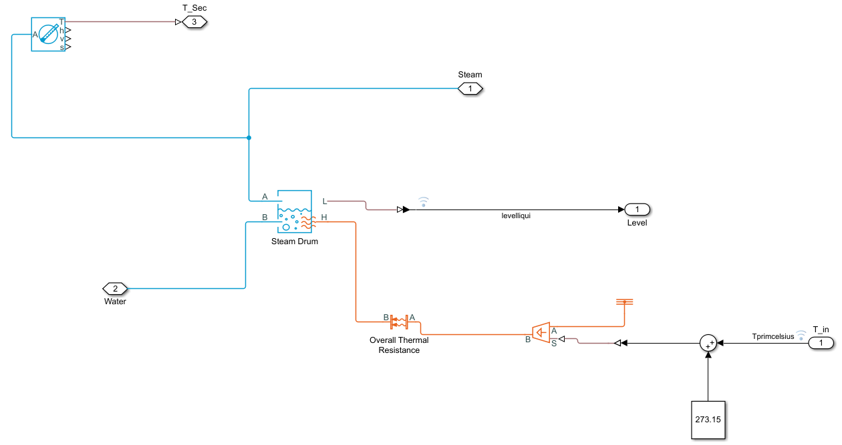
Simscape components
3
BOILER
Coupling between reactor and secondary side
Convective thermal resistance
Input: fluid from pump
Output : saturated steam to the turbine
Ouput : liquid volume fraction to PI controller
Problem → Propulsion Model → Damages → Port model → Results

Slide 5
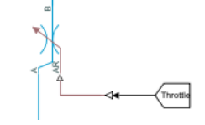
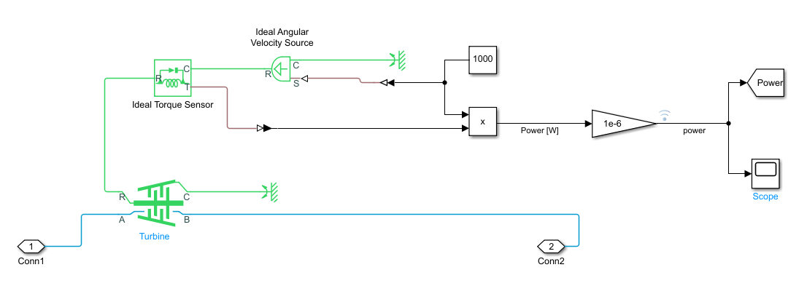
Simscape components
4
THROTTLE VALVE
Model of a pressure drop
Output : Admission steam to turbine
AR/Throttle imposed by PI controller
TURBINE
Inlet and outlet port for the fluid
Mechanical rotational conserving ports
Ideal torque sensor & Ideal angular velocity source
Output power to the PI controller
Problem → Propulsion Model → Damages → Port model → Results

Slide 6
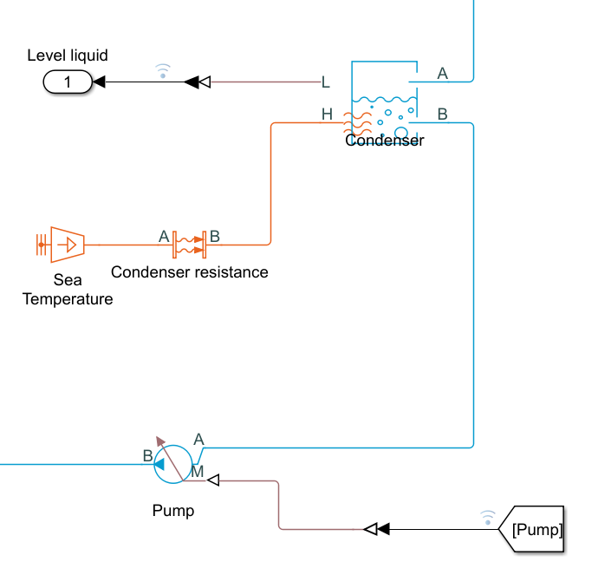
Simscape components
5
CONDENSER
Saturated Fluid Chamber
Input : fluid from Turbine
Output : fluid to the pump
Output : liquid level
Sea Temperature = 15 [°C]
PUMP
IDEAL mechanical energy source
Input : saturated liquid from condenser
Input : mass flowrate from PI controller
Problem → Propulsion Model → Damages → Port model → Results

Slide 7
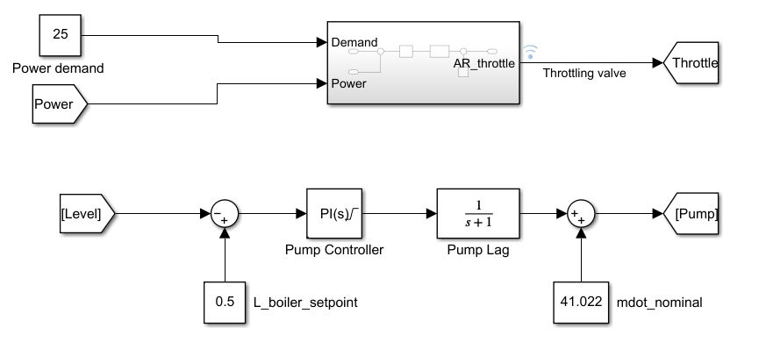
Simscape components
6
PI CONTROLLERS
Restriction area of the control Valve regulation to satisfy power demand
(2) Mass flowrate to the pump regulation according to the liquid level in the boiler
SENSORS
- Sensors chosen according to damage (to be continued…)
Problem → Propulsion Model → Damages → Port model → Results

Slide 8
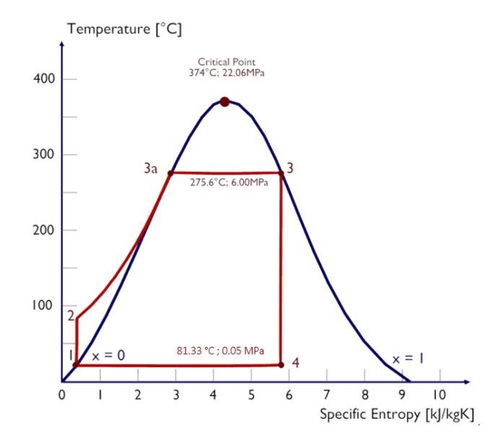
Rankine cycle
7
x = 73.79 %
mdot_nominal = 41.022 [kg/s]
input thermal power = 100 [MWth]
Problem → Propulsion Model → Damages → Port model → Results

Slide 9
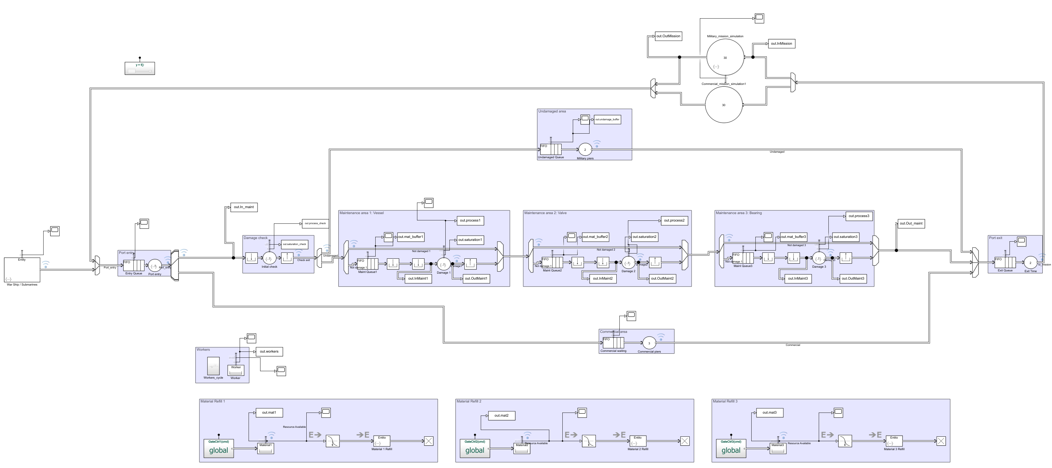
Maintenance operations: the port model
Failure repair → Maintenance area operations
Port flow mapping:
Maintenance areas
Warehouses
Waiting area
Load/unload areas
Workers behaviour
Performance analysis
Cost analysis
Problem → Propulsion Model → Damages → Port model → Results

Slide 10
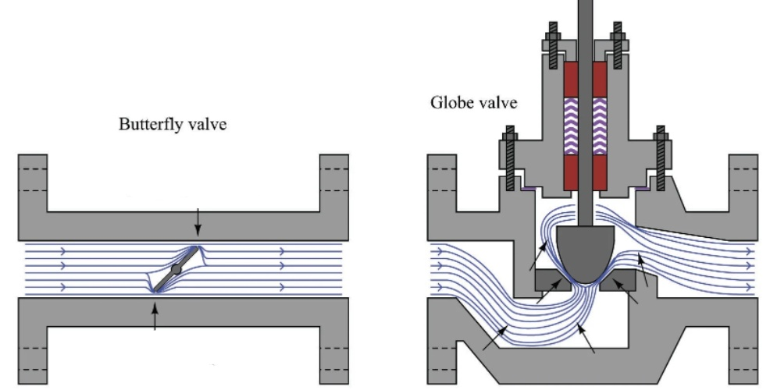
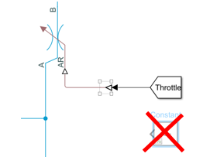
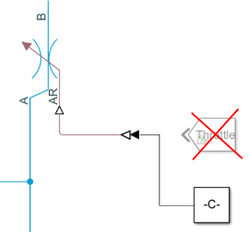
Damage 1: Valve
8
NOMINAL CONDITION
Power demand = 25 [MW]
Throttle = 0.009 [m²]
SENSORS
Pressure sensor at the outlet of the valve
Power sensor output of the turbine
CORROSION & MATERIAL DEPOSITION
± 30 % nominal valve passage area
PI controller regulation
NO detection of differences
CORROSION
CORROSION & FOULING
Problem → Propulsion Model → Damages → Port model → Results

Slide 11
Damage 1: Valve 1ST MODEL
9
ANN
Two saparate ANN for power and pressure
Input : valve passage area
Output : mean of last 100 second measurements
Sweep from 0.009 to 0.0117 m² (severe damage : +30% nominal value)
nftool
1ST MODEL
PI CONTROLLER
CORROSION ONLY
PERFORMANCE ASSESSMENT
areaValve= 0.01102 m²
Problem → Propulsion Model → Damages → Port model → Results

Slide 12
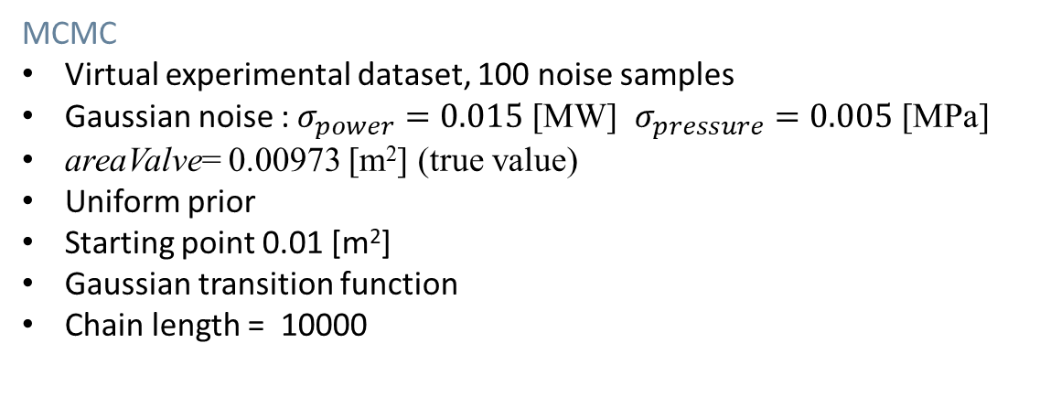
Damage 1: Valve 1ST MODEL
10
MCMC
Virtual experimental dataset, 100 noise samples
Gaussian noise : $σ_{power}=0.015$ [MW] $σ_{pressure}=0.005$ [MPa]
areaValve= 0.00973 [m²] (true value)
Uniform prior
Starting point 0.01 [m²]
Gaussian transition function
Chain length = 10000
Problem → Propulsion Model → Damages → Port model → Results

Slide 13
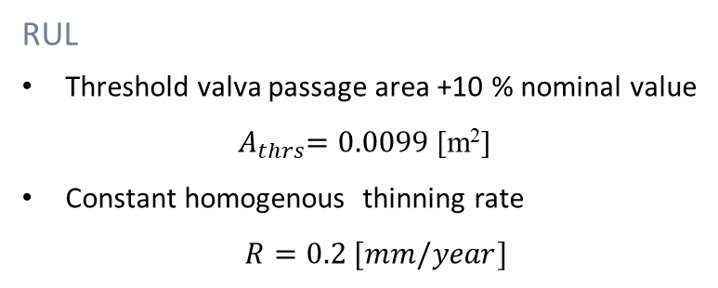
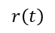
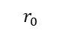
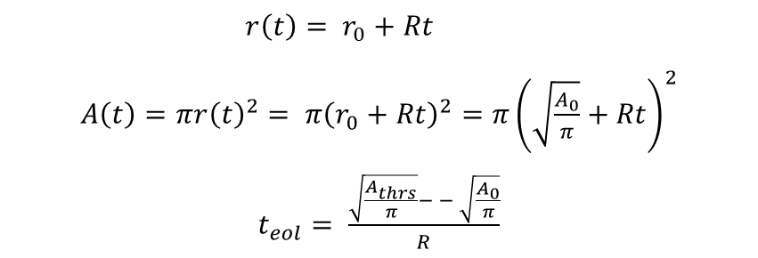
Damage 1: Valve 1ST MODEL
11
RUL
Threshold valva passage area +10 % nominal value
${ A}_{thrs}=0.0099$ [m²]
Constant homogenous thinning rate
$R=0.2 [mm/year]$
$$r_{0}$$
$$r\left(t\right)$$
$r\left(t\right)= r_{0}+Rt$
$A\left(t\right)=π{r\left(t\right)}^{2}= π{\left(r_{0}+Rt\right)}^{2}=π{\left(\sqrt{\frac{A_{0}}{π}}+Rt\right)}^{2}$
$t_{eol}= \frac{\sqrt{\frac{A_{thrs}}{π}}− − \sqrt{\frac{A_{0}}{π}}}{R}$
Problem → Propulsion Model → Damages → Port model → Results

Slide 14
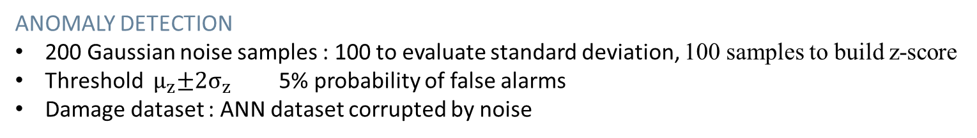
Damage 1: Valve 1ST MODEL
12
ANOMALY DETECTION
200 Gaussian noise samples : 100 to evaluate standard deviation, 100 samples to build z-score
Threshold ${ μ}_{z}±2σ_{z}$ 5% probability of false alarms
Damage dataset : ANN dataset corrupted by noise
Problem → Propulsion Model → Damages → Port model → Results

Slide 15
Damage 1: Valve 2ND MODEL
13
ANN
Sweep from 0.0063 to 0.0117 m² (severe damage : ±30% nominal value)
2ND MODEL
NO PI CONTROLLER
CORROSION & FOULING
PERFORMANCE ASSESSMENT areaValve= 0.01102 m²
Problem → Propulsion Model → Damages → Port model → Results

Slide 16
Damage 1: Valve 2ND MODEL
14
MCMC
areaValve= 0.00813 [m²] (true value)
Problem → Propulsion Model → Damages → Port model → Results

Slide 17

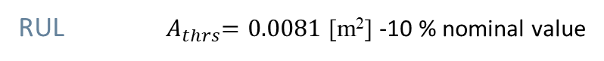
Damage 1: Valve 2ND MODEL
15
RUL ${ A}_{thrs}=0.0081$ [m²] -10 % nominal value
$$R=−0.05 [mm/year]$$
Problem → Propulsion Model → Damages → Port model → Results

Slide 18
Damage 1: Valve 2ND MODEL
16
ANOMALY DETECTION
Problem → Propulsion Model → Damages → Port model → Results

Slide 19
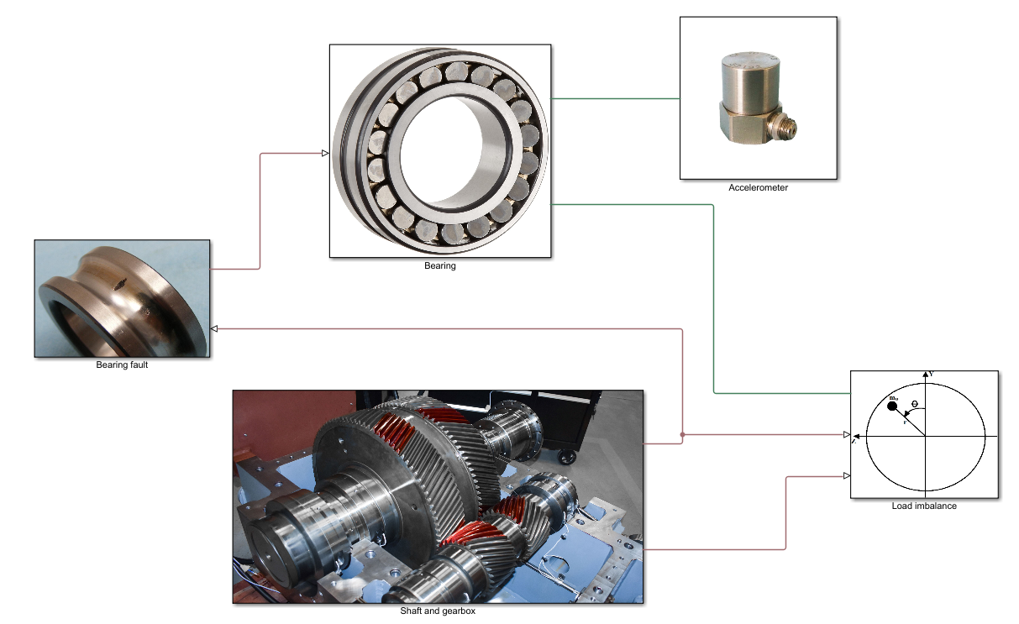
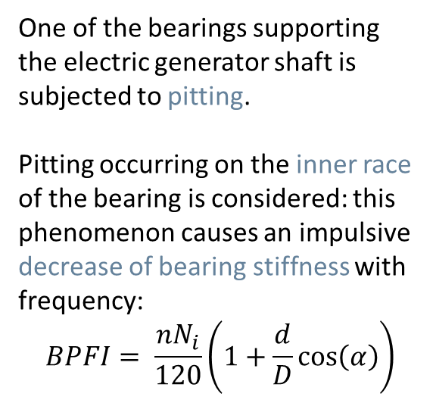
Damage 2: Bearing
17
One of the bearings supporting the electric generator shaft is subjected to pitting.
Pitting occurring on the inner race of the bearing is considered: this phenomenon causes an impulsive decrease of bearing stiffness with frequency:
$$BPFI= \frac{nN_{i}}{120}\left(1+\frac{d}{D}\cos\left(α\right)\right)$$
The force acting on the bearing is due to load imbalance of the rotor and it’s synchronous with the shaft rotation.
Problem → Propulsion Model → Damages → Port model → Results

Slide 20
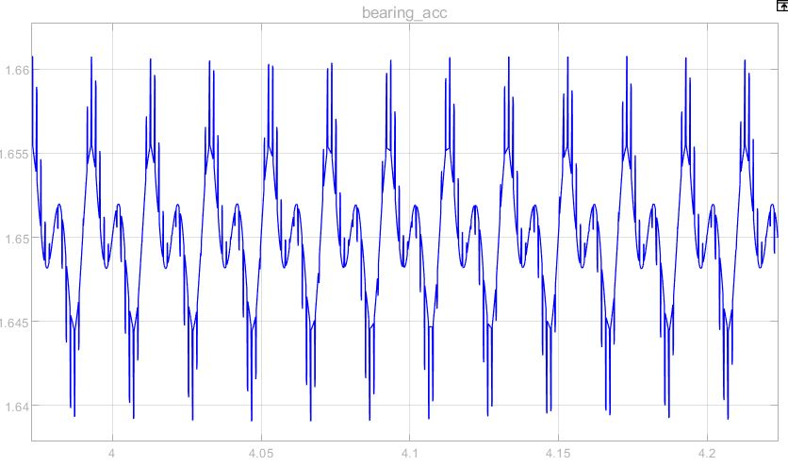
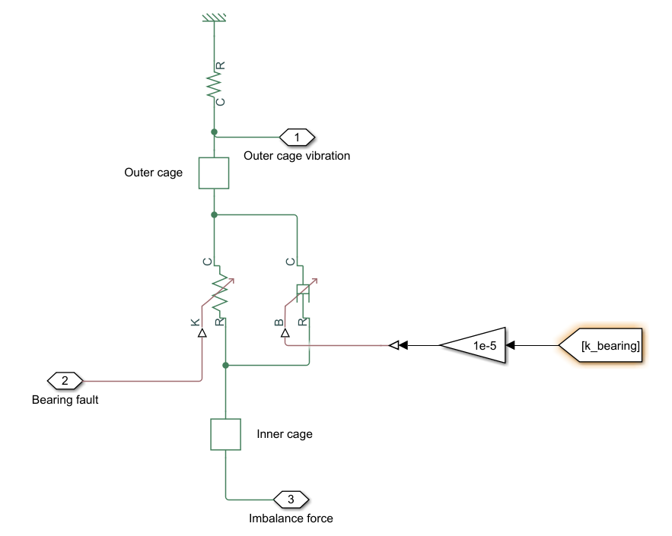
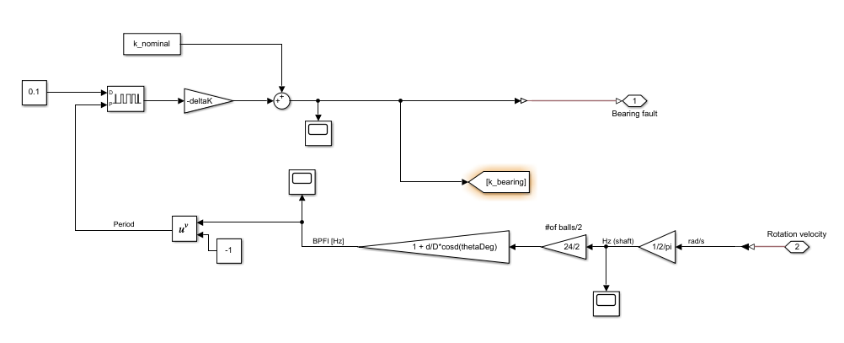
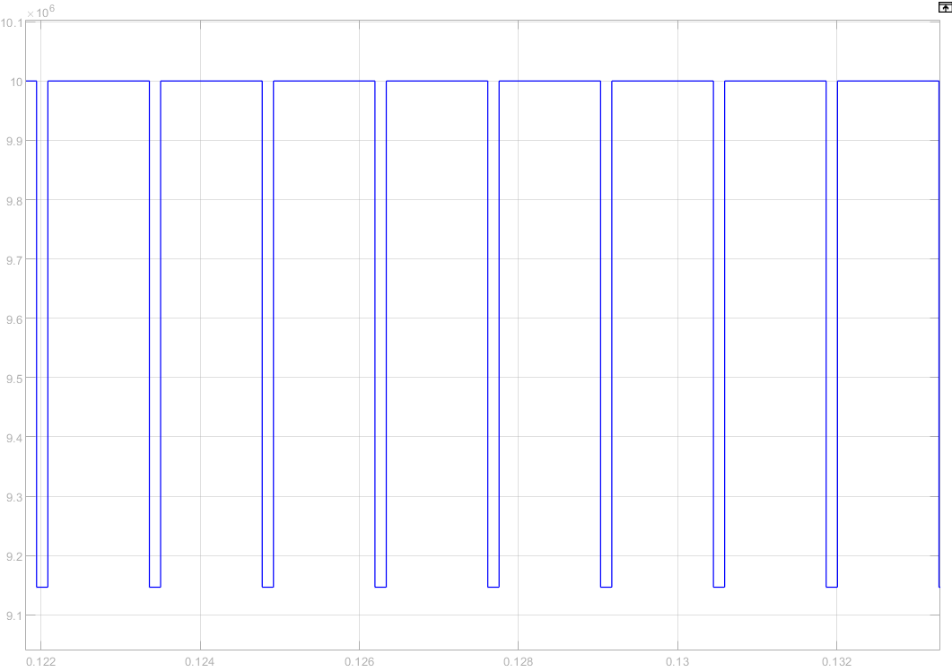
Damage 2: Bearing
18
Starting from the nominal stiffness of the bearing (1e7 N/m), this value is decreased by a quantity Δk that depends on the depth of the damage according to a formula that interpolates the following values:
With no defect, Δk is equal to 0
With 0.1 mm deep pit, Δk is equal to 8e4 N/m
With 1 mm deep pit (limit value), Δk is equal to 9e6 N/m.
Problem → Propulsion Model → Damages → Port model → Results

Slide 21
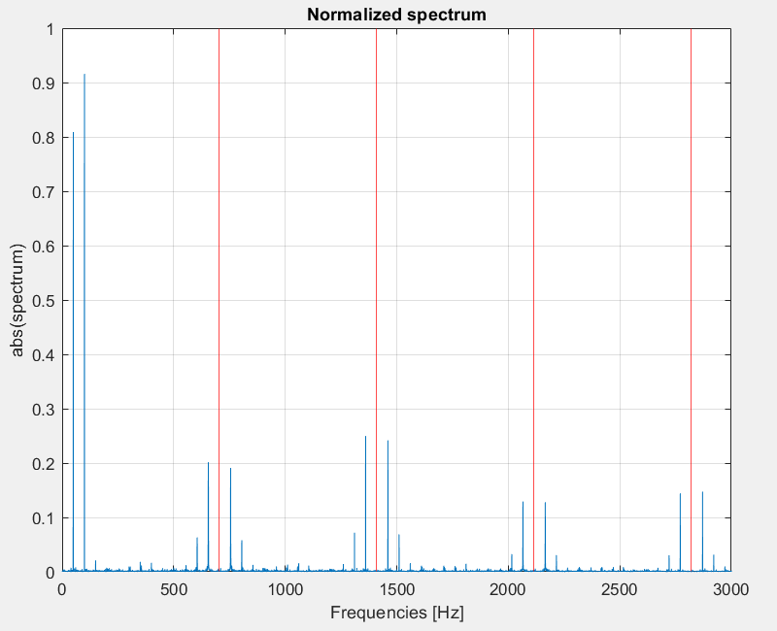
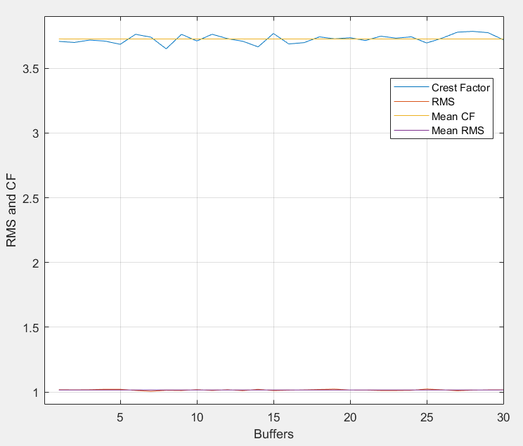
Damage 2: Bearing
19
FREQUENCY AND TIME ANALYSIS
Fourier transform of the acquired signal (with pit depth 0.4 mm) yields this spectrum. Components centered at frequencies around BPFI arise. However, it’s difficult to evaluate health basing on the spectrum of the signal.
Time domain analysis allows to compute the Crest Factor, that is an indicator of impulsive peaks of vibrations. It’s more efficient than RMS.
Problem → Propulsion Model → Damages → Port model → Results

Slide 22
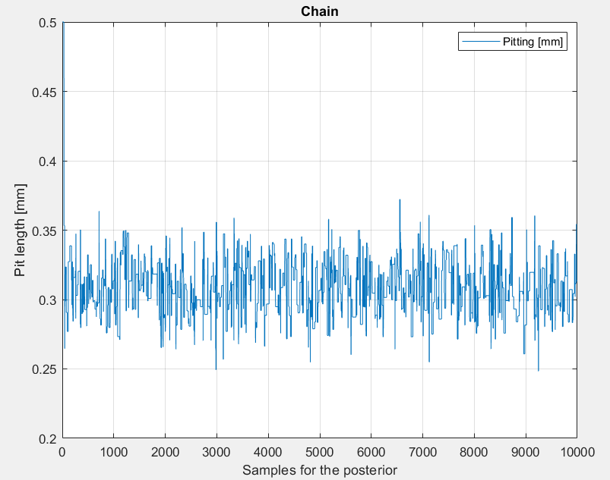
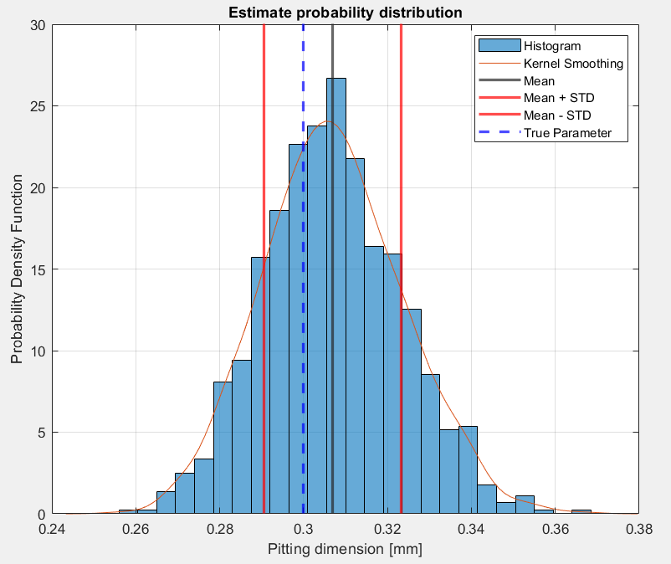
Damage 2: Bearing
20
ANN AND MCMC
An ANN is trained for a pit depth between 0.1 mm and 1 mm. Output of the ANN is the CF.
Then, MCMC for the evaluation of the pit depth was built. The prior distribution is an uniform distribution between 0 and 1 mm depth; the transition distribution is normal with properly tuned variance. The generated MCMC approaches well the real value of the parameter.
Problem → Propulsion Model → Damages → Port model → Results

Slide 23
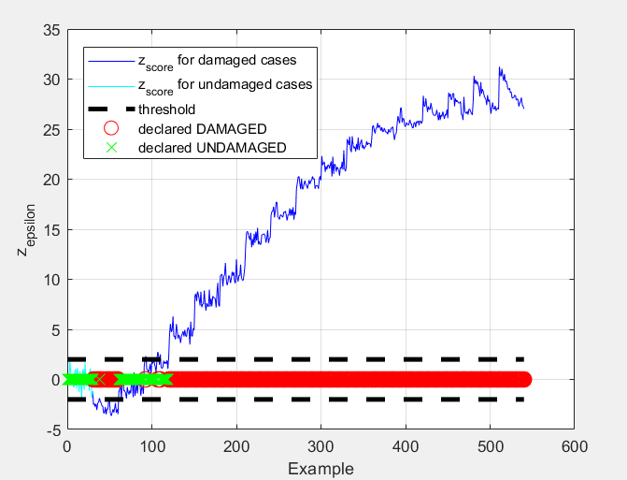
Damage 2: Bearing
21
ANOMALY DETECTION
First the model is run in undamaged condition. Z-score with respect to Crest Factor is computed and limits for anomaly detection are determined at mean(z-score) ± 2std(z-score).
Then the model is run with pit depth varying from minimum to maximum value and z-scores are computed: damage starts to be detected from 0.3 mm deep pit.
Problem → Propulsion Model → Damages → Port model → Results

Slide 24
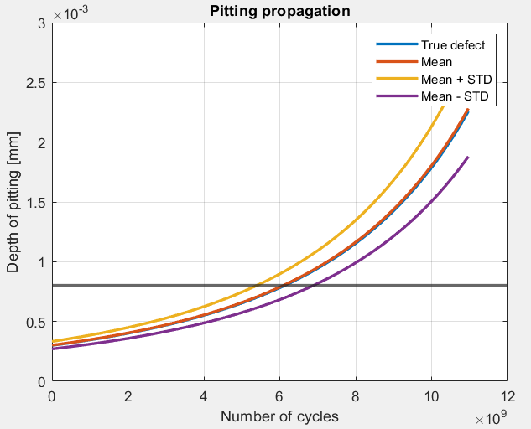
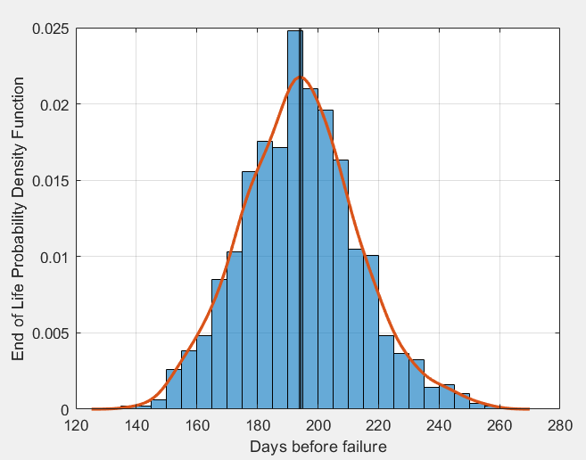
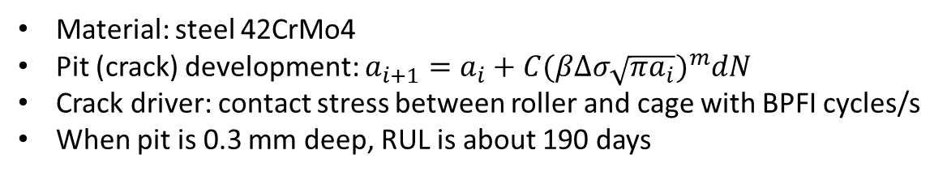
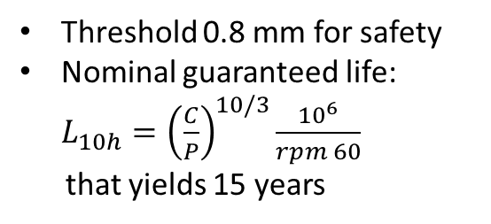
Damage 2: Bearing
22
RUL ESTIMATION
Material: steel 42CrMo4
Pit (crack) development: $a_{i+1}=a_{i}+C{(βΔσ\sqrt{πa_{i}})}^{m}dN$
Crack driver: contact stress between roller and cage with BPFI cycles/s
When pit is 0.3 mm deep, RUL is about 190 days
Threshold 0.8 mm for safety
Nominal guaranteed life: $L_{10h}={\left(\frac{C}{P}\right)}^{10/3}\frac{{10}^{6}}{rpm 60}$
that yields 15 years
Problem → Propulsion Model → Damages → Port model → Results

Slide 25
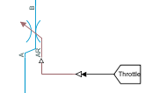
Damage 3: Crack propagation due to pressure fluctuation
23
PHENOMENON OF PRESSURE FLUCTUATION
Variation in the power demand
Power control obtained using a throttle valve
Throttle valve increases the pressure inside the reactor pressure vessel (RPV)
Problem → Propulsion Model → Damages → Port model → Results

Slide 26
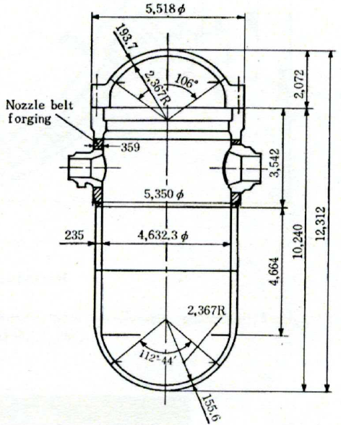
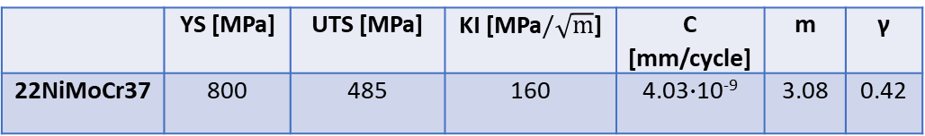
Damage 3: Crack propagation due to pressure fluctuation
24
CHARACTERISTICS OF THE RPV
RPV material 22NiMoCr37
 | YS [MPa] | UTS [MPa] | KI [MPa$/\sqrt{m}$] | C [mm/cycle] | m | γ
22NiMoCr37 | 800 | 485 | 160 | 4.03$∙$10⁻⁹ | 3.08 | 0.42
Problem → Propulsion Model → Damages → Port model → Results

Slide 27
Damage 3: Crack propagation due to pressure fluctuation
25
STRESS DISTRIBUTION
 | Axial [MPa] | Hoop [MPa] | Radial [MPa]
Mean | 31.6570 | 70.0642 | -6.7503
Alternate | 2.8590 | 6.3275 | -0.6096
σ_{axial nominal} = 28.7980 MPa
σ_{axial reduced} = 34.5159 MPa
σ_{hoop nominal} = 63.7367 MPa
σ_{hoop reduced} = 76.3917 MPa
σ_{radial nominal} = -6.1407 MPa
σ_{radial reduced} = -7.3599 MPa
Problem → Propulsion Model → Damages → Port model → Results

Slide 28
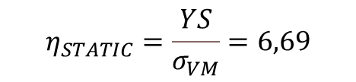

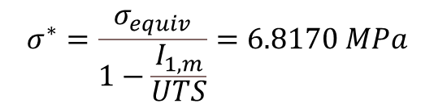
Damage 3: Crack propagation due to pressure fluctuation
26
RESISTANCE ASSESMENT
- Static assesment
$$σ_{VM}=\sqrt{{σ_{ax}}^{2}+{σ_{r,max}}^{2}+{σ_{c,max}}^{2}−σ_{ax}σ_{r,max}−σ_{ax}σ_{c,max}−σ_{r,max}σ_{c,max}}=72,53 MPa$$
$$η_{STATIC}=\frac{YS}{σ_{VM}}=6,69$$
- Fatigue assesment
$$σ^{∗}=\frac{σ_{equiv}}{1−\frac{I_{1,m}}{UTS}}=6.8170 MPa$$
$$σ^{′}=0.3∙UTS∙m_{s}∙m_{d}=214.2 MPa$$
$$η_{FATIGUE}=\frac{σ^{′}}{σ^{∗}}=31.42$$
Problem → Propulsion Model → Damages → Port model → Results

Slide 29
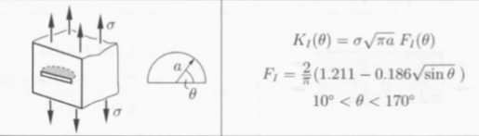
Damage 3: Crack propagation due to pressure fluctuation
27
CRITICAL CRACK CALCULATIONS
A semicircular crack was considered
θ = 90°
β = 0.65253527
Critical crack length
a_{critical plastic} = 6605 mm
a_{critical brittle} = 658.23 mm
RPV is a critical component
Therfore a conservative critical crack length dimension is 117.5 mm
If a failure occurs it will be a brittle failure
Problem → Propulsion Model → Damages → Port model → Results

Slide 30
Damage 3: Crack propagation due to pressure fluctuation
28
Dataset
RUL in cycles: 3381 cycles
RUL in days: 1127 days
RUL in years: 3 years
Particle filter estimation
RUL
Please note that the crack propagates from a 30 mm initial crack length
Problem → Propulsion Model → Damages → Port model → Results

Slide 31
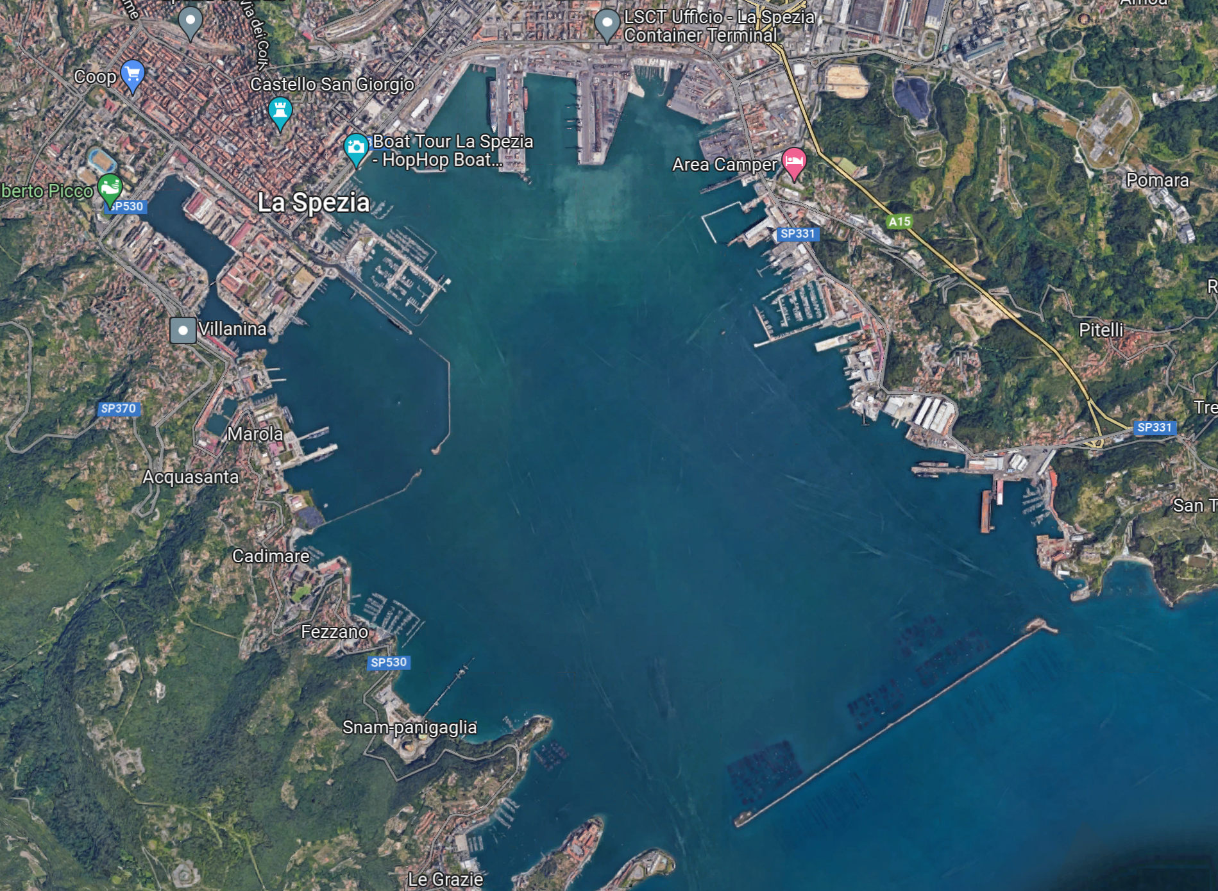
Maintenance activity: the reference framework
29
Reference port layout, La Spezia (Italy):
2 zones: Military area and civil area
Military area:
Maintenance operations
Daily operations piers
Civil area:
Daily operations piers (load / unload)
Shared port entry and port exit
Problem → Propulsion Model → Damages → Port model → Results

Slide 32
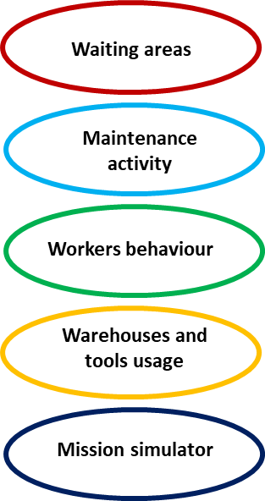
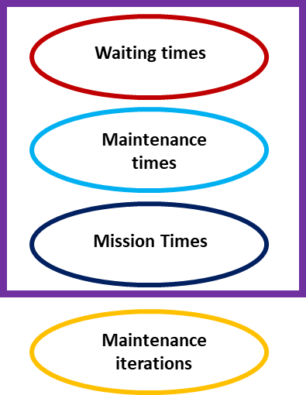
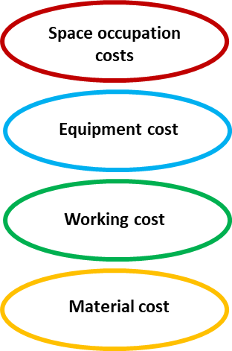
Maintenance activity: the problem
30
MODEL ELEMENTS
PERFORMANCE INDICATORS
COST INDICATORS
Port framework and model elements are necessary to derive:
CHARATERISTICS TIMES
PERFORMANCE INDICATORS
COST INDICATORS
SCENARIOS | STANDARD SCENARIO | DIGITAL TWIN SCENARIO
Type of maintenance | Predetermined (time-based) and scheduled | Predictive, based on the RUL calculated with the developed models
Distinctive element | The maximum allowed lifetime of each component of the analysis (pressure vessel, valve, bearing) is the only difference between the two scenarios. It will be integrated in the block called Port entry.
Common elements | Every parameter of the analysis is not differential between the two scenarios: working times, number of ships and simulation time are the same.
Indicators → Scenario comparison
OUTPUT → Feasibility in DT adoption
Problem → Propulsion Model → Damages → Port model → Results

Slide 33
Maintenance activity: the general model
31
Modelled ships:
9 aircraft carriers
9 war submarines
32 commercial boats
Ship launch interval:
80 days
Useful modeled life
14600 days (40 years)
Launch
Undamaged area
Mission
Maintenance / Undamaged area
Military ship lifecycle
Problem → Propulsion Model → Damages → Port model → Results

Slide 34
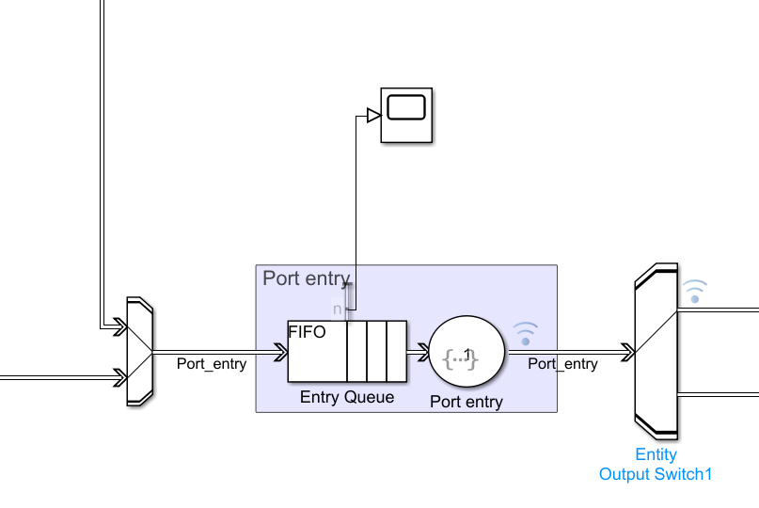
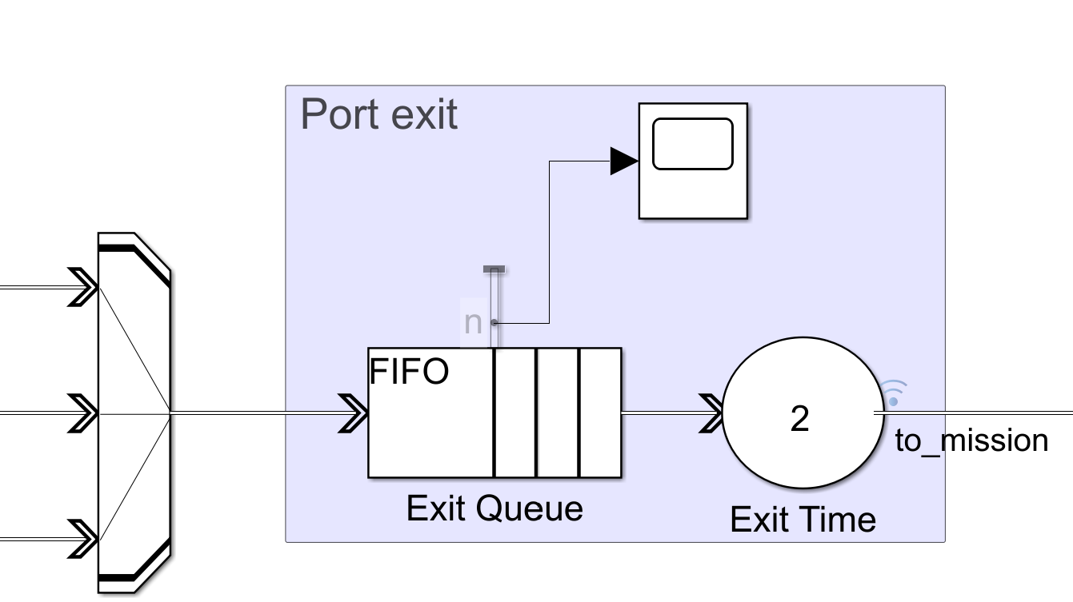

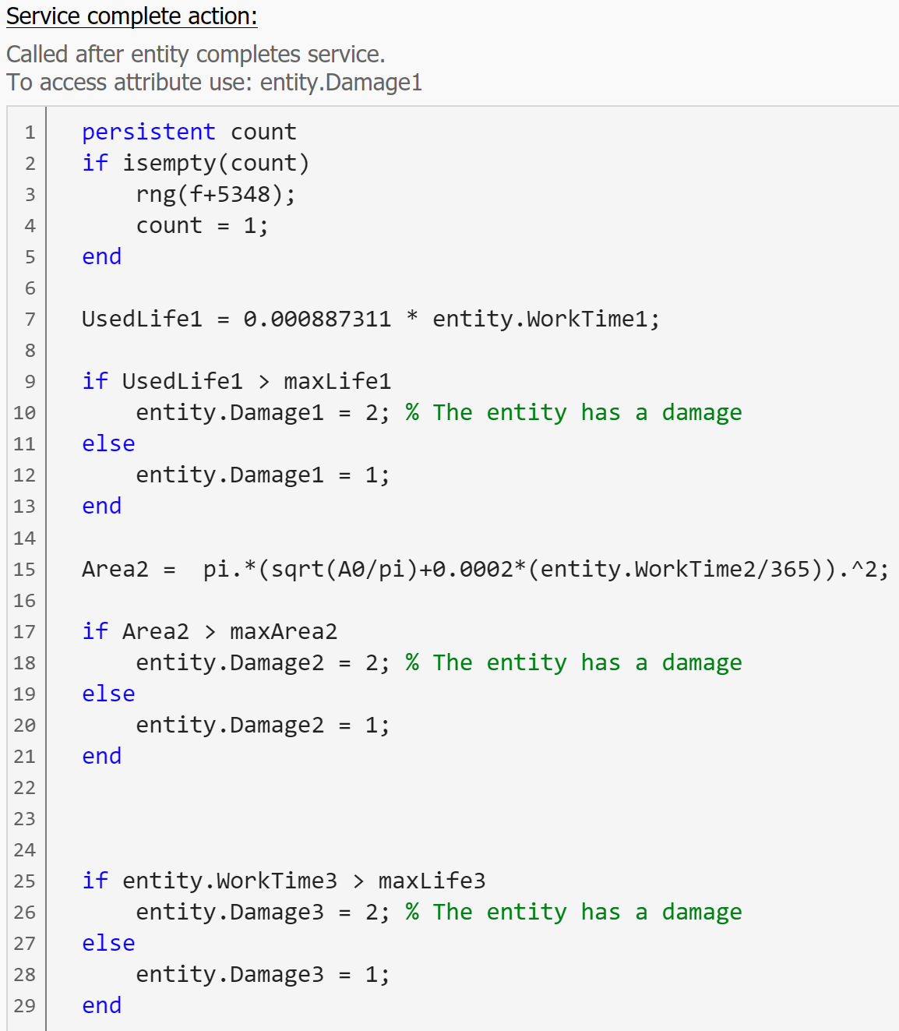
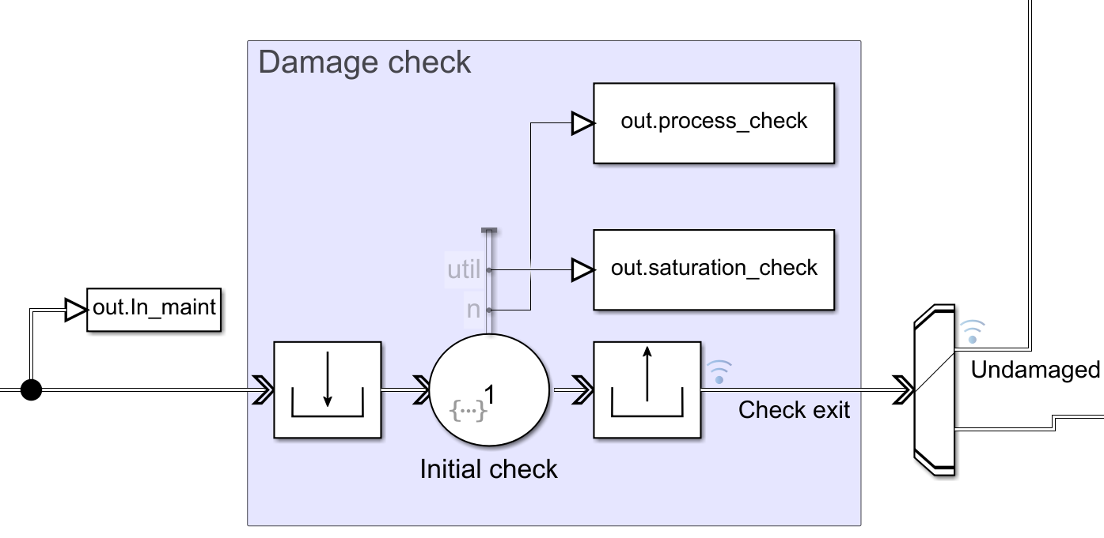
Maintenance activity: Focus
32
PORT ENTRY
DT scenario
Max lifespan depend on developed RUL models
Max lifespan is reduced by 234 days (99.7% of mission duration)
PORT EXIT
Standard scenario
Max lifespan depend on literature data
Paths are aggregated before the physical port exit
Entity.Damage attribute is changed
DAMAGE CHECK
Path is chosen according to IsDamaged attribute
Problem → Propulsion Model → Damages → Port model → Results

Slide 35
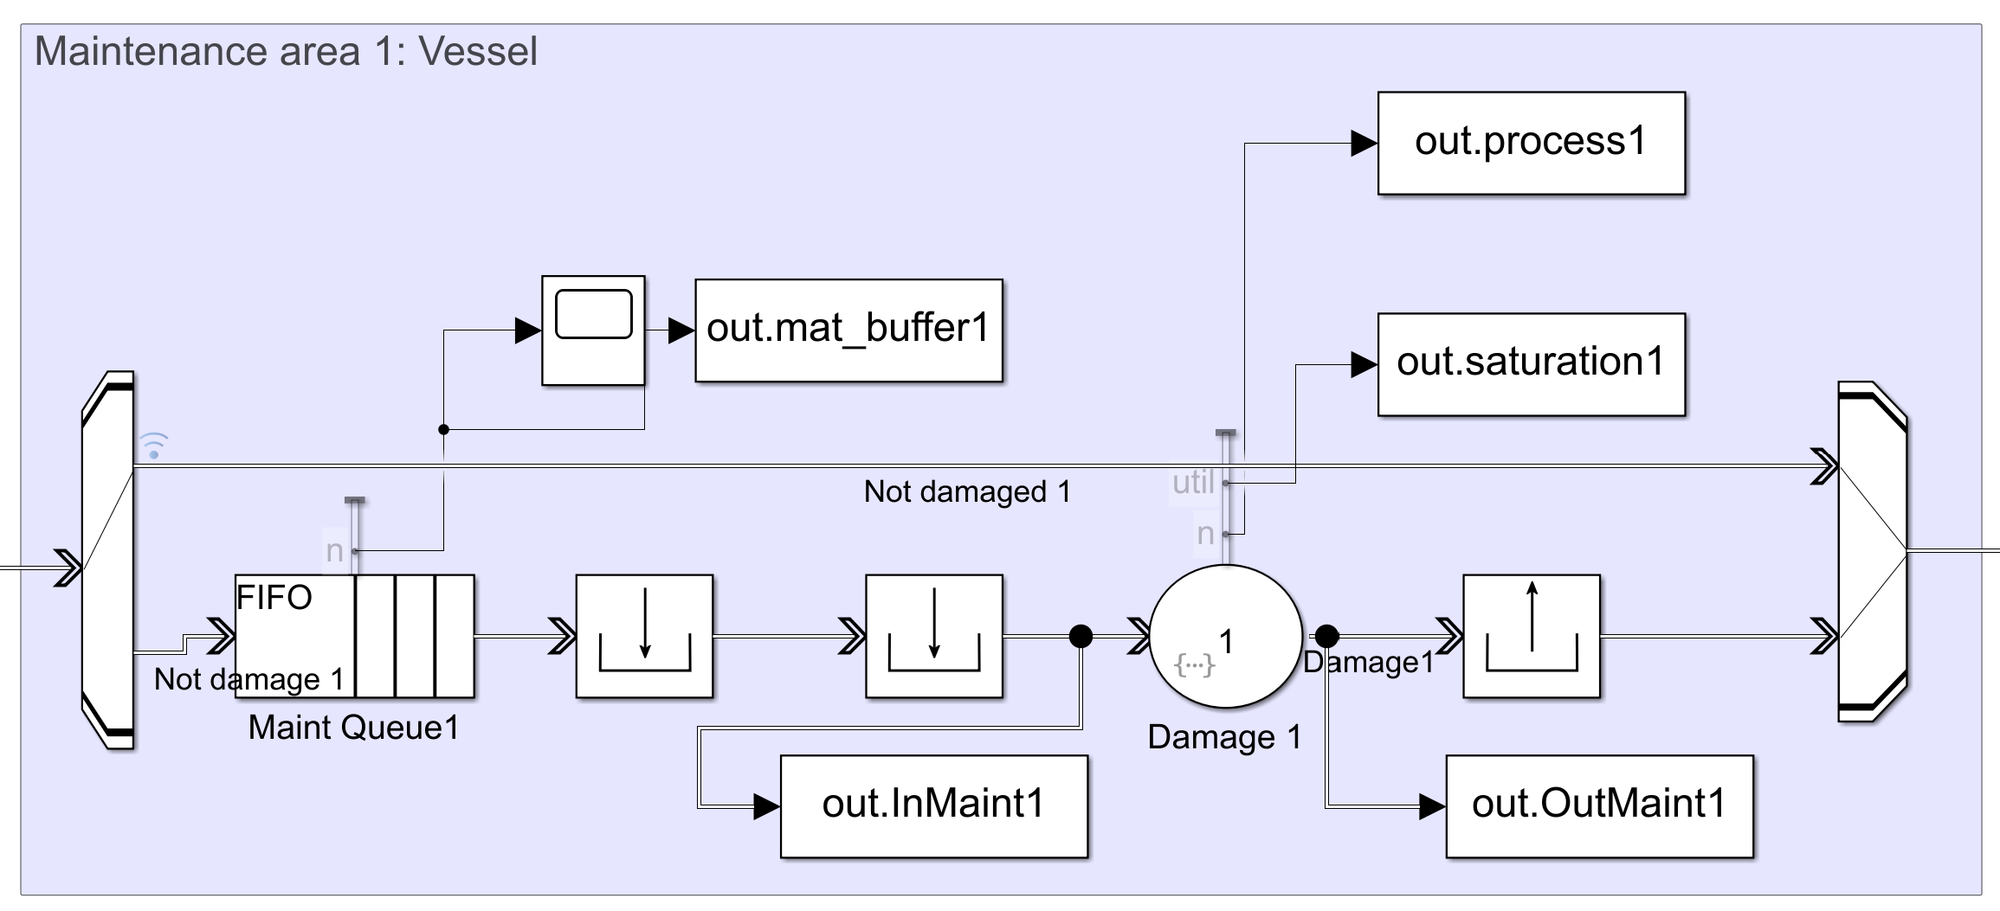


Maintenance activity: Focus
33
Maintenance areas and warehouses are specific for each type of failure: 3 repair areas and 3 tool stocks
MAINTENANCE AREA
WAREHOUSES
Initial capacity: 20 repair kits
Replenishment threshold: 2 kits
Entry depends on entity.Damage attribute
4 workers per maintenance area, repair tool is taken from the warehouse
Dedicated waiting area
Process times differs according to different type of vessel / type of damage
Problem → Propulsion Model → Damages → Port model → Results

Slide 36


Maintenance activity: Focus
34
Not maintenance-linked areas → same port resources → congestion
DAILY OPERATION - MILITARY AREA
DAILY OPERATION – CIVIL AREA
Every commercial boat
Load/unload operations
Mean time: 7 hours
3 dedicated piers
Undamaged military vessels
Arming the warship/submarine for the next mission
Mean arming time: 6 days
2 dedicated piers
Eventual waiting area
Problem → Propulsion Model → Damages → Port model → Results

Slide 37



Maintenance activity: Focus
35
PERSONNEL MANAGEMENT
MISSION SIMULATOR
5 mission scenarios
Cumulated entity.WorkTime is updated
Military: from 25 to 180 days
Civil: 11 days
Workers pool: 14 operators per each turn
3 turns/day; 7 days/week
Involved in maintenance (4 x 3) and check activities (2)
10%: daily illness probability
Illness days: from 3 to 6
Problem → Propulsion Model → Damages → Port model → Results

Slide 38
Maintenance activity: Performance and cost analysis
36
MODEL ELEMENTS
PERFORMANCE INDICATORS
COST INDICATORS
CHARATERISTICS TIMES
Maintenance waiting area
Energy, space occupation, machinery utilisation
Lifetime status analysis
Worked hours
Total repair cycles
Kit used
Problem → Propulsion Model → Damages → Port model → Results

Slide 39



Maintenance activity: Total repair cycles
37
SINGLE SHIP REPAIR CYCLES
FLEET AGGREGATED REPAIR CYCLES
-36.3%
-13.4%
-22.6%
-35.6%
-13.0%
-36.9%
Intra-scenario
Highlight single behaviour variability
DT lower than standard case
Bearing is the least repaired
Submarines lower than warships
Valve repair cycles: lowest benefit
Problem → Propulsion Model → Damages → Port model → Results

Slide 40




Maintenance activity: Total repair cycles
38
TOTAL MISSION TIMES
FLEET REPAIR CYCLES / MISSION DAY
9.6%
10.4%
-41.9%
-21.6%
-29.6%
-41.7%
-21.2%
-42.9%
DT scenario → fewer repair cycles → more “useful life”
STD showed similar behaviours
Higher mission time → higher improvement
Problem → Propulsion Model → Damages → Port model → Results

Slide 41




Maintenance activity: Total repair cycles
39
TOTAL MAINTENANCE TIMES
GLOBAL RESULT
8%
10%
6%
73%
71%
66%
7.5%
78%
-24.3%
-24.7%
Same trend of repair cycles
DT: Higher efficiency → higher productivity
Problem → Propulsion Model → Damages → Port model → Results

Slide 42




Maintenance activity: Total repair cycles
40
COSTS BY COST INDEX
MATERIAL COSTS
SPACE COSTS
EQUIPMENT COSTS
WORKING COSTS
73%
26.4 M€
31.9 M€
27.6 M€
83.7 M€
8.49 B€
11.1 B€
8.3 M€
10.9 M€
Standard case → higher costs + higher variability
Space cost → highest variability for standard case
Problem → Propulsion Model → Damages → Port model → Results

Slide 43


Maintenance activity: Total repair cycles
41
COSTS BY COST INDEX
TOTAL COSTS
PERCENTAGE ANALYSIS
Lowest improvement Material costs
-17.3%
Highest improvement Space costs
-67.3%
73%
Median improvement Space costs
-23.7%
8.6 B€
11.2 B€
Problem → Propulsion Model → Damages → Port model → Results

Slide 44





Possible improvements
42
Sophie Deanesi
Davide Fracasso
Zeno Mancassola
MSc in Nuclear Engineering
MSc in Mechanical Engineering
MSc in Mechanical Engineering
Marine steam turbine plant model
Valve damage
Marine steam turbine plant model
Crack progation
Bearing model & damage
73%
Paolo Pontillo
Davide Portello
MSc in Management Engineering
MSc in Management Engineering
Port model
Performance & cost analysis
Port model
Performance & cost analysis

Slide 45
THANK YOU FOR THE ATTENTION

